Slide 1

History and examination
of abdomen, & pelvis
Mohammed Al Sebayel
Professor of Surgery

Slide 2
History taking
ALL PATIENTS PRESENT WITH A PROBLEM !
How to solve it?
  HISTORY
  CLINICAL EXAMINATION
  CLINICAL DIAGNOSIS
  INVESTIGATIONS
  FINAL DIAGNOSIS
  TREATMENT

Slide 3
History taking
Record date of history taking and examination
Introduce yourself
Explain & seek permission
Full attention
Treat with respect
Let patient talk
Guide, not dictate
No leading question
No short-cuts
Try not to write and talk at the same time

Slide 4
History taking
PERSONAL DETAILS
PRESENTING COMPLAINT
HISTORY OF PRESENT ILLNESS
SYSTEMIC INQUIRY
PAST MEDICAL/SURGICAL HISTORY
FAMILY HISTORY
HISTORY OF MEDICATIONS
SOCIAL HISTORY
OTHER HISTORY (Gyn. )

Slide 5
History taking
PERSONAL
  NAME
  AGE
  SEX
  NATIONALITY
  MARITAL STATUS
  OCCUPATION

Slide 6
History taking
PRESENTING COMPLAINT
  What are you complaining of?
    (record in patient’s own words)
  When more than one complain:
    Record in order of:
      Severity
      Chronicity

Slide 7
History taking
HISTORY OF PRESENT ILLNESS
  Full analysis of the complain or complaints
  Get right back to the beginning of the trouble
  Analysis of the possible related systems

Slide 8
History taking
COMMON COMPLAINTS
  Abdominal pain
  Abdominal mass/ swelling
  Abdominal distension
  Changes in bowel habit
  Vomiting
  Discharge (abdomen, perineum)
  Bleeding
  Weight loss

Slide 9
History taking
Analysis of pain
  1. Site: where is the pain?
    Patients point with- finger vs hand
  2. Locations (Great degree of overlap)
    Right hypochondrium.- Hepatobiliary, gallbladder
    Left hypochondrium.- Spleen
    Epigastrium.- Stomach and duodenum
    Lumber- kidney
    Umbilical- small bowel, caecum, retroperitoneal
    Right iliac fossa- Appendix, caecum
    Left iliac fossa- Sigmoid colon
    Hypogastrium- Colon, urinary bladder, adenexae

Slide 10
History taking
Analysis of pain
  3. Onset :
    Slow: inflammation
    Sudden: perforation, ischemia
  4. Duration: acute or chronic
  5. Severity: Numeric Pain Rating Scale (1-10)
    4-6 – moderate pain
    Mild beginning- inflammation
    Severe- perforation, ischemia

Slide 11
History taking
Analysis of pain
  6. Nature:
    Dull (inflammation),
    Sharp (rupture viscus),
    Colic (intermittent)
    Throbbing (abscess)
  7. Progression:
    Steady increase (inflammation),
    Fluctuating (colic)

Slide 12
History taking
Analysis of pain
  8. Aggravating factors:
    Fatty foods increases pain in gallstone disease
    Eating
    Fasting
  9. Relieving factors:
    Sitting & leaning forward eases pain- acute pancreatitis.
    Eating relieves pain- duodenal ulcer

Slide 13
History taking
Analysis of pain
  10. Radiation or referred pain:
    Shoulder- cholecystitis,
    Groin- ureteric colic
    Shifting or migration:
      periumbilical to RIF in acute appendicitis
  11. Cause:
    Trauma,
    Food from outside- gastroenteritis
    Medication (NSAID)- perforation, bleeding

Slide 14
History taking
Swelling or mass
  When noticed?
    Acute (hematoma, abscess)
    chronic- neoplasm, organomegaly
  How noticed?
    Incidentally noticed swelling may be present for longer duration
  Painful or painless?
    Inflammatory, neoplasm

Slide 15
History taking
Swelling or mass
  Change in size
    since first noticed? Increase- neoplasms,
    disappear or reduce in size-?hernias/ improved inflammation
  Aggravating/relieving factors:
    Hernias increase in size with activity/cough
  Any cause?
    Trauma- hematoma, cough- hernia

Slide 16
History taking
Vomiting
  Non- bilious: Early stage, late- pyloric obstruction
  Bilious: bowel obstruction
  Faeculent: late stage of bowel obstruction
  Blood: Duodenal ulcer, oesophageal varices, tumor
  Vomiting relieves pain- gastric ulcer
  Vomiting food taken few days ago: pyloric stenosis

Slide 17
History taking
Bowel habit
  Constipation:
    habitual, recent (neoplasm)
  Absolute constipation (obstipation):
    Intestinal obstruction
  Diarrhoea:
    duration (acute, chronic),
    number of stool,
    any blood or mucous (IBD),
  Color of stool:
    Bright red (anal, rectum), maroon (colon) black- melena (upper GI)

Slide 18
History taking
History of discharge
  Site: anal, perineum, wound
  Duration
  Nature:
    purulent (anal fistula), bloody (hemorrhoid), fecal from wound ( int. fistula)
  Relationship to defecation/stool
    mixed with stool- IBD, independent of stool- hemorrhoids
  Any pain?
    Hemorrhoids
    Anal fistula

Slide 19
History taking
SYSTEMIC INQUIRY
  Begin with the involved or affected (chief complain) system
  Example: If the chief complaint is related to gastrointestinal system(GI)- continue with the GIT inquiry.

Slide 20
History taking
GIT
Weight- amount, duration
Appetite
Dysphagia
Nausea
Vomiting
Heartburn
Haematemesis
Flatulence
Jaundice
Abdominal pain
Fat intolerance
Constipation
Diarrhoea
Melena
Rectal bleeding
Stool

Slide 21
History taking
Respiratory system:
  Cough, sputum, hemoptysis, wheeze, dyspnea, chest pain
Cardiovascular system:
  Angina (cardiac pain), dyspnea ( rest/ exercise),
  Palpitations, ankle swelling, claudication

Slide 22
History taking
Obstetric & Gynecology
  LMP
  Vaginal discharge
  Vaginal bleeding
  Pregnancies
Nervous system
  Headache
  Fits
  Depression
  Facial/limb weakness

Slide 23
History taking
METABOLIC/ENDOCRINE
  Muscular pain
  Bone & Joint pain
  Swelling of joints
  Limitation of movements
  Weakness

Slide 24
History taking
METABOLIC/ENDOCRINE
  Bruising/ bleeding (nutrients deficiencies)
  Sweating (thyrotoxicosis)
  Thirst (diabetes)
  Pruritus (skin infection, jaundice, uremia, Hodgkin’s)
  Alcohol
  Weight loss- ?dieting, amount and duration

Slide 25
History taking
PAST HISTORY
  Rheumatic Fever
  Tuberculosis/ asthma
  Diabetes
  Jaundice
  Blood transfusion
  Mental illness
  Operations/ accident

Slide 26
History taking
FAMILY HISTORY
  Diabetes
  Hypertension
  Heart disease
  Malignancy
  Cause of death
*Father/Mother/Siblings/Spouse/Children/Grand parents / Close relatives

Slide 27
History taking
HISTORY OF MEDICATIONS
  Insulin
  Steroids
  NSAID
  Contraceptive pills
  Antibiotics
  Others

Slide 28
History taking
SOCIAL HISTORY
  Marital status
  Occupation
  Travel abroad
  Accommodation
  Habits ( smoking, alcohol )
  Dependent relatives

Slide 29
History taking
Psychiatric/ emotional background
Allergies
  Food
  Drugs
Immunizations
  Tetanus
  Diphtheria
  Tuberculosis
  Hepatitis
  Others

Slide 30
Abdominal exam
Before starting clinical examination:
Analyze patient’s history.
Probable diagnostic possibilities
Think of the common diseases
Determine physical findings consistent with these entities.
Permission
Privacy
Presence of a nurse
Precautions

Slide 31
Abdominal exam
  Observe your patient while history taking for:
    General health- emaciated (? Malignancy)
    Intelligence
    Attitude
    Mental state (dehydration, encephalopathy)
    Posture:
      Peritonitis- flexed & still
      Intestinal, biliary or renal colic- rolling around in agony
    Mobility

Slide 32
Abdominal exam
4 parts
  Inspection
  Palpation
  Percussion
  Auscultation
Practice a standard routine every time
Hand- head to toe
Head to toe

Slide 33
Abdominal exam
Weight- loss (malignancy), gain (DU)
Pulse (Tachycardia- infection, fluid/ blood loss
Blood pressure (low- fluid loss, bleeding)
Temperature ( Fever- infection)
Respiration rate- raised in infections

Slide 34
Abdominal exam
Pulse- rate, rhythm, volume, nature
Nails- koilonychia, clubbing, leukonychia
Skin- dehydration, moist palm, anemia
Anemia- conjunctiva, nail bed
Jaundice- sclera, under surface of tongue
Oral cavity- mucous membrane for hydration , tongue for coating
Scalp
Ear/ nose

Slide 36
Abdominal exam
Neck- vein, goiter, lymph nodes, other swellings
Chest- asymmetry, expansion, breath sound, added sound
Cardiac- rhythm, heart sound, murmur
Limbs- asymmetry, swelling, movement, pulses, power
Abdomen (local examination)

Slide 37
Abdominal exam
Abdomen:
  Exposure: nipples to knees (ideal)
  Cover genitalia
  Patient lying flat on a pillow
  Arms by the side ( not under the head!)
  Sit or kneel beside the patient
  Adequate light

Slide 38
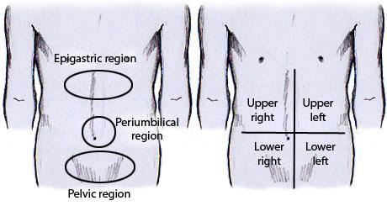
Inspection

Slide 39
Inspection
Asymmetry- from the foot end of the bed - mass
Movement with breathing (restricted in peritonitis)
Swelling/ mass- location
Distension- central (SIO) or peripheral (LBO, ascites)
Scar, sinus, wounds
Prominent veins- portal hypertension
Umbilicus- shape, discharge, swelling
Cough impulse- groin, umbilicus, scar

Slide 40
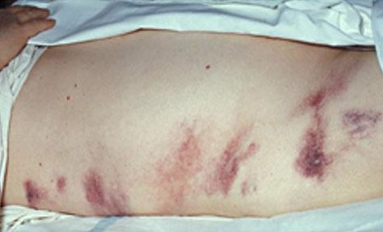
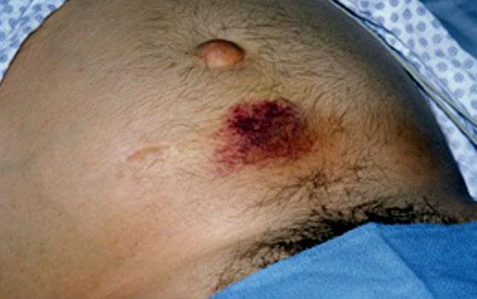
Grey- Turner sign Cullen sign

Slide 41
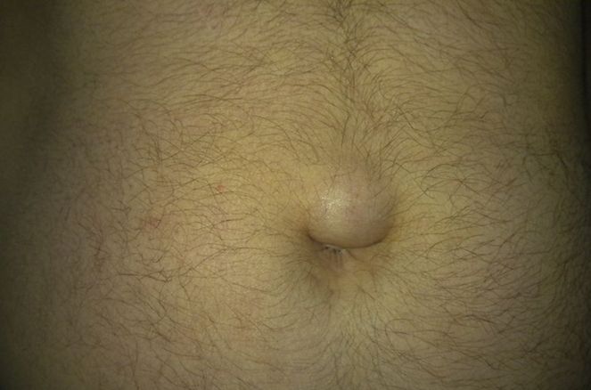
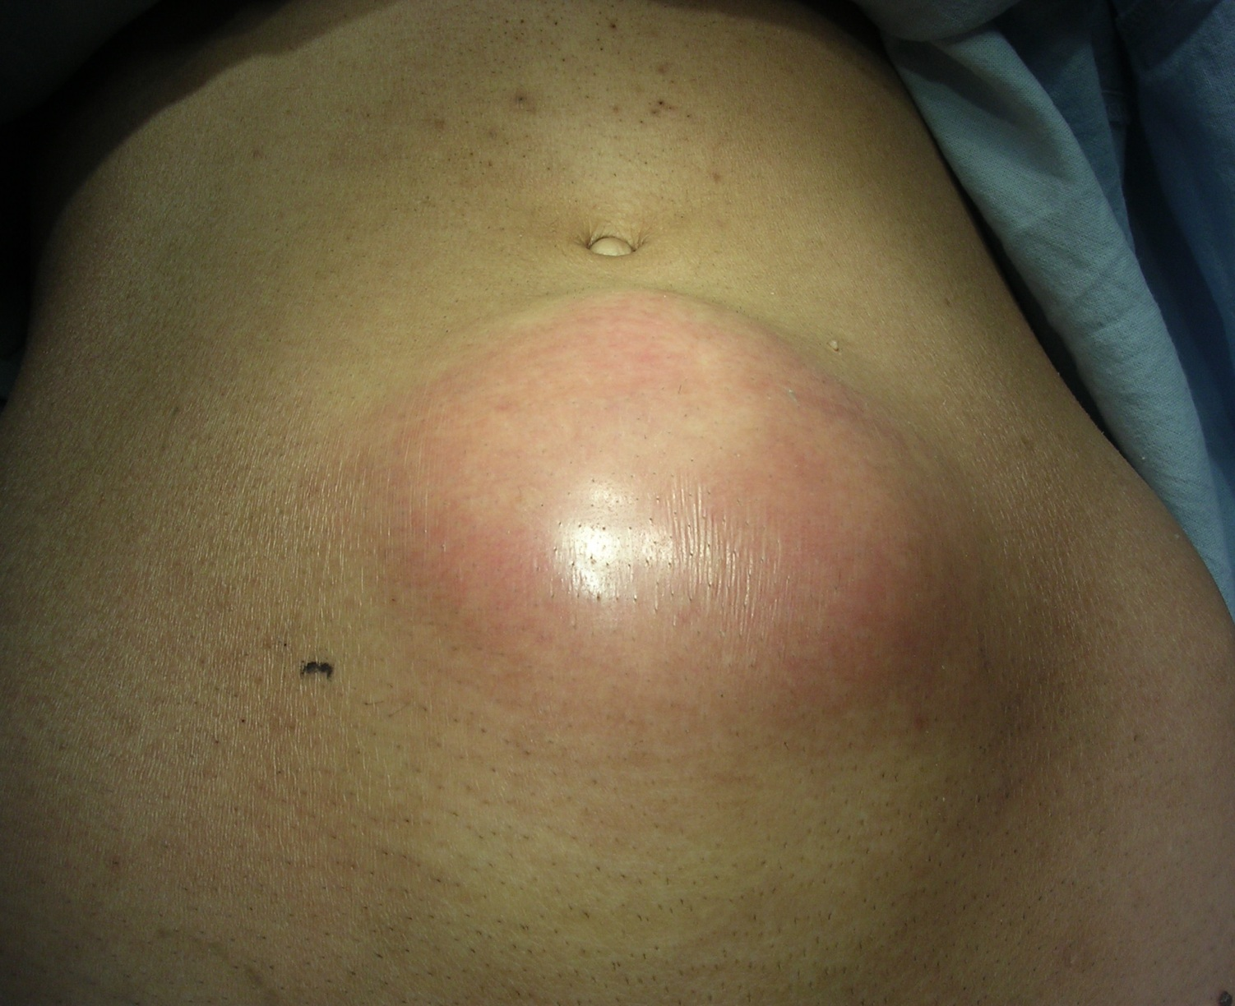
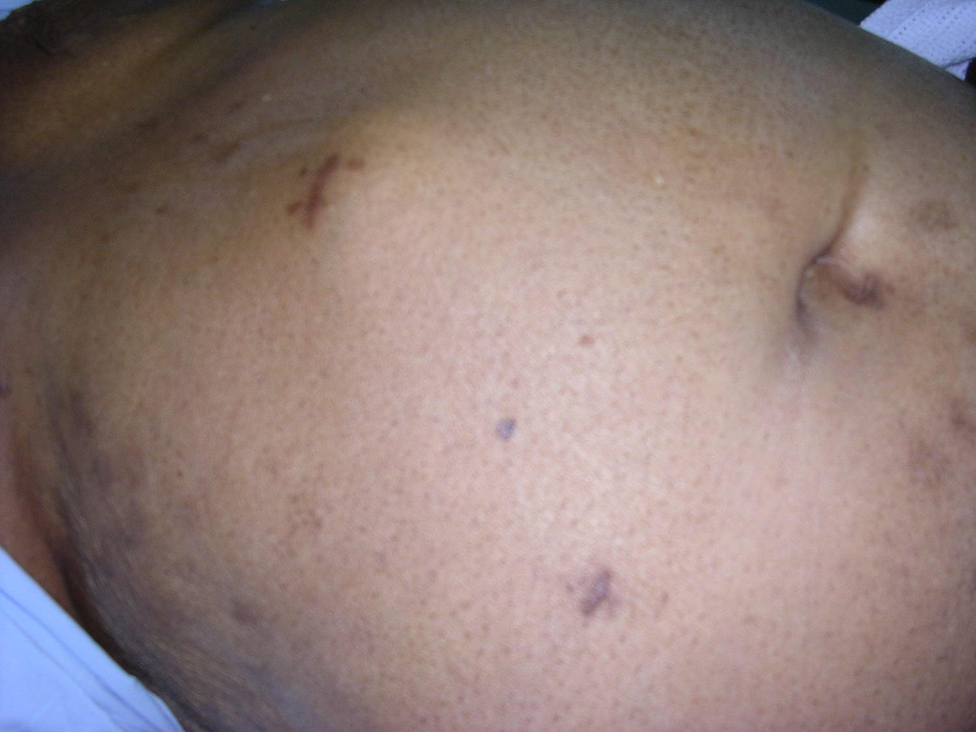

Slide 42
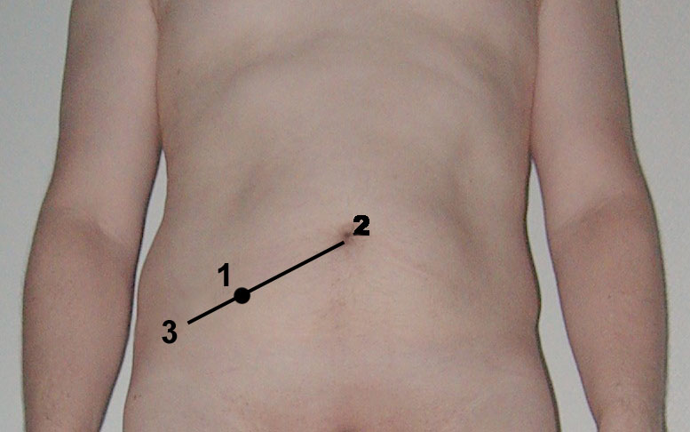
Palpation
Gentle/ superficial palpation:
  Start away from the area of pain
Deep palpation:
  Deep tenderness-
  Guarding: muscle contracted overlying
  the tender area (acute inflammation)
  Mc Burney’s point,
Abdominal signs:
  Rebound/ Rovsing’s
  Murphy's
  Obturator
  Psoas

Slide 43
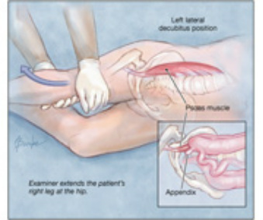
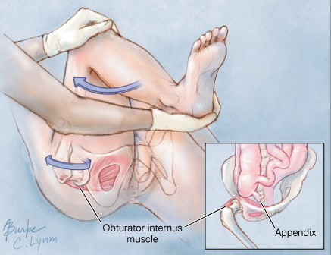
  Psoas sign Obturator sign

Slide 44
Palpation
Organomegaly: liver , spleen, kidneys
Other masses- abdominal wall or intra-abdominal
Define all features of a mass: site, size, surface, borders, tenderness, pulsation, mobility
Cough impulse

Slide 45
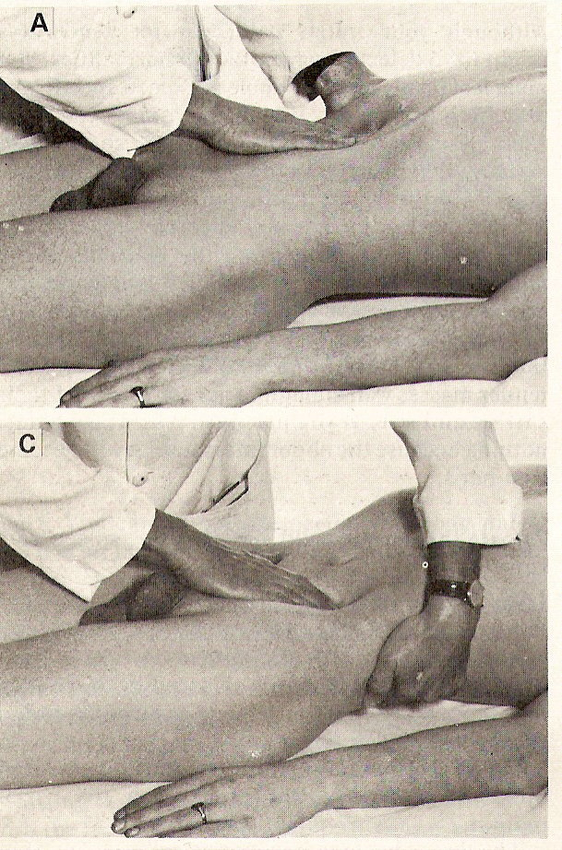
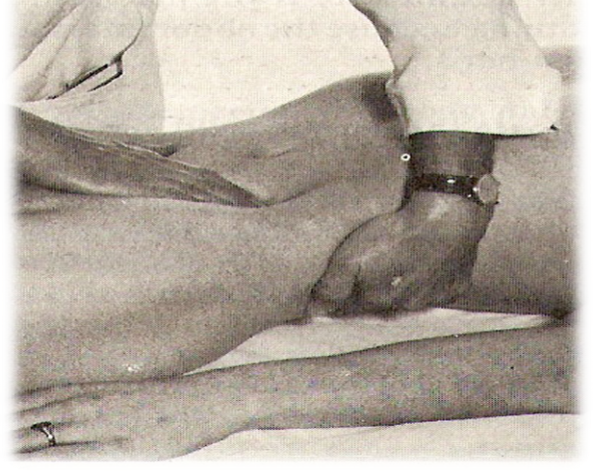

Slide 46
Palpation
Mass in RUQ:
  Ca. hepatic flexure, enlarged gallbladder, enlarged right kidney, hepatomegaly
Mass in epigastric region:
  Liver, gastric carcinoma, abdominal aortic aneurysm
Mass in LUQ:
  Splenomegaly, carcinoma descending colon, swelling in tail of pancreas,
  Enlarged left kidney
Mass in periumbilical region:
  PUH, ca. transverse colon, tumour deposit (Sister Mary Joseph's nodule)

Slide 47
Palpation
Mass in LLQ:
  Descending colon (Benign, malignant Carcinoma)
  Sigmorectal
Mass in the suprapubic region:
  Distended urinary bladder, pregnancy, ovarian mass
Mass in RLQ:
  Appendiceal disease, ca. ascending colon, Crohn's disease of ileo-caecal area
Mass in inguinal region:
  Hernia, lymphadenopathy, aneurysm

Slide 48
Percussion
Organs and masses
Liver span
Ascites:
  Fluid thrill (large amount)
  Shifting dullness

Slide 50
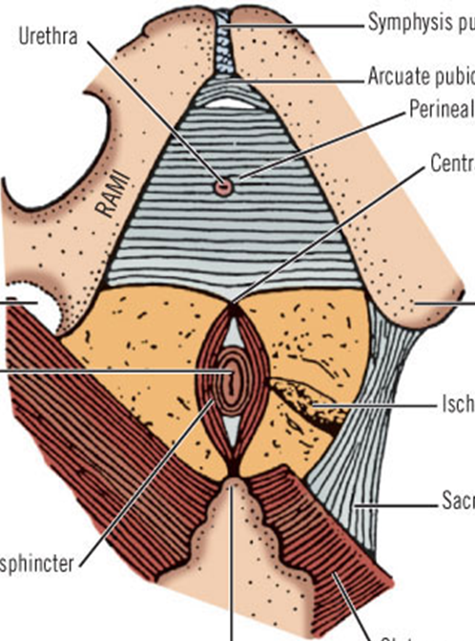
Perineum

Slide 51
Presenting history
Pain:
  perianal abscess, fissure in ano, anal fistula, thrombosed piles
Bloody discharge:
  Piles, fissure, fistulae, tumours (polyp, carcinoma anus/ rectum)
Purulent discharge:
  perianal abscess, fissure in ano, anal fistula
Mass or swelling:
  Abscess, piles, neoplasms

Slide 52
Examination
Perineum examination:
Left lateral decubitus position-
  hips flexed to 90º and knees flexed to
  less than 90°.
  Lift- uppermost buttock to expose
  the area
Jack-knife position

Slide 53
Examination
Inspection:
  scar of previous surgery,
  Sinus- one opening blind track
  Fistula- track connecting two epithelial surfaces
  Fecal soiling, blood/mucous discharge
  Mass protruding from anus
Palpation: tenderness, discharge, mass
Rectal examination: Tone, tenderness, mass, prostate, blood, stool

Slide 54
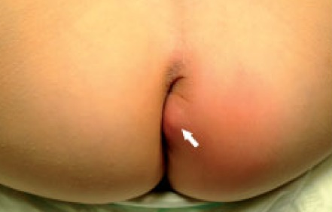
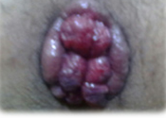

Slide 55
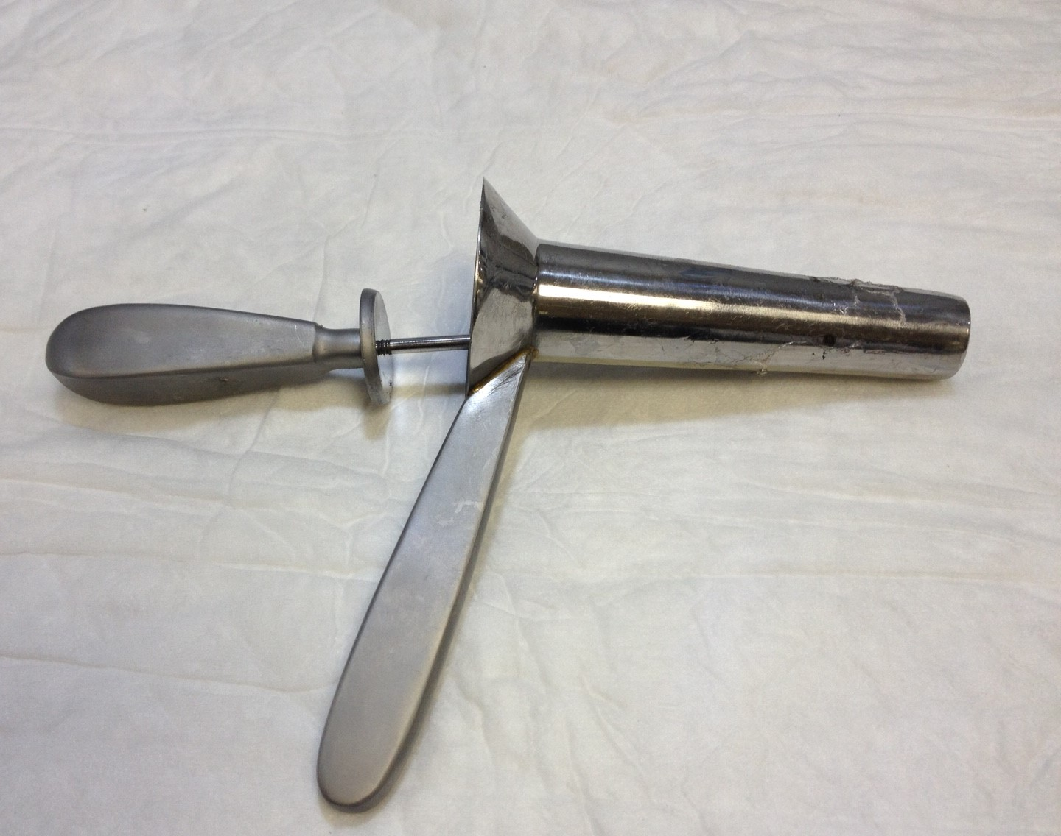

Slide 56
Thanks

